Slide 1



MH
Pressing On:
Maximizing Our Optimism

Slide 2

Our Agreements
Step up Step Back
Offer Grace to ourselves then to others
What happens here stays here. What’s learned here is shared.
We value the process over perfection.

Slide 3


Core
Core signifies the essential and unchanging heart that defines your fundamental principles, values, or central aspects.

Slide 4
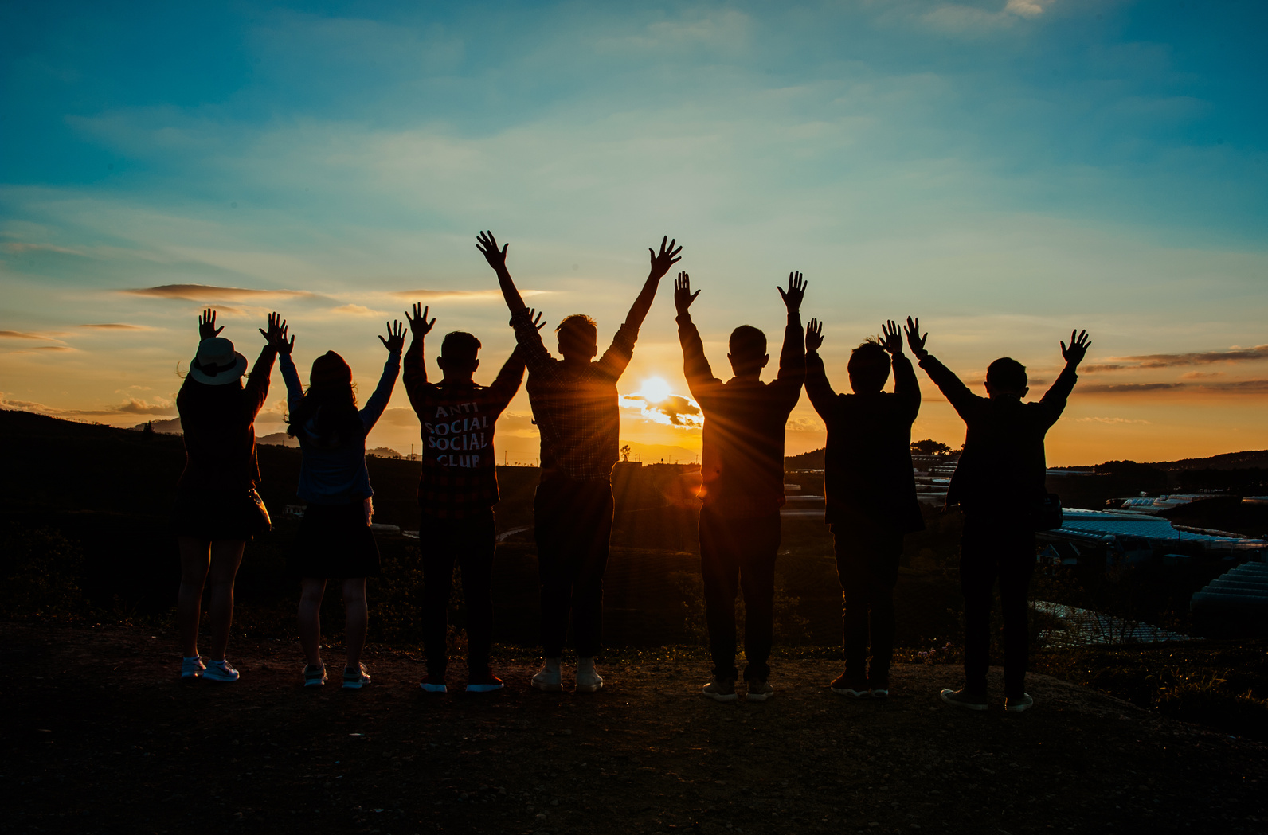
People
to People

Slide 5
What’s your favorite Color?

Slide 6
Remember:
What made you interested in joining this group?

Slide 7
When was the last time you felt fully seen and appreciated?

Slide 8

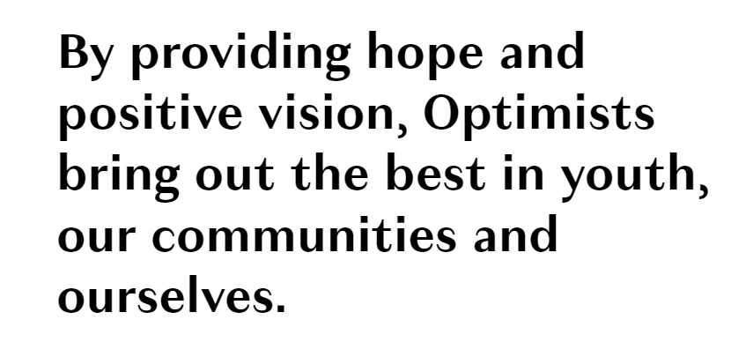

Slide 9


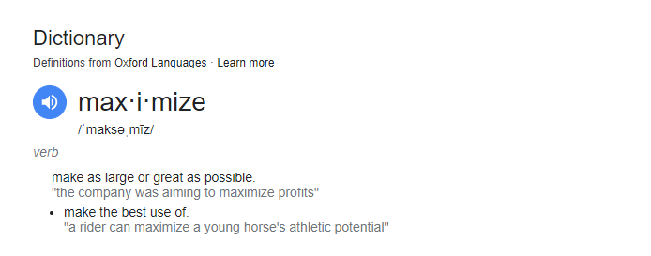
Enlarge
Magnify
Boost
Amplify
To Maximize

Slide 10
To be so strong that nothing can disturb your peace of mind. To talk health, happiness and prosperity to every person you meet. To make all your friends feel that there is something in them. To look at the sunny side of everything and make your optimism come true. To think only of the best, to work only for the best, and to expect only the best. To be just as enthusiastic about the success of others as you are about your own. To forget the mistakes of the past and press on to the greater achievements of the future. To wear a cheerful countenance at all times and give every living creature you meet a smile. To give so much time to the improvement of yourself that you have no time to criticize others. To be too large for worry, too noble for anger, too strong for fear, and too happy to permit the presence of trouble.
Optimist
Creed
PROMISE YOURSELF

Slide 11
To be so strong that nothing can disturb your peace of mind. To talk health, happiness and prosperity to every person you meet. To make all your friends feel that there is something in them. To look at the sunny side of everything and make your optimism come true. To think only of the best, to work only for the best, and to expect only the best. To be just as enthusiastic about the success of others as you are about your own. To forget the mistakes of the past and press on to the greater achievements of the future. To wear a cheerful countenance at all times and give every living creature you meet a smile. To give so much time to the improvement of yourself that you have no time to criticize others. To be too large for worry, too noble for anger, too strong for fear, and too happy to permit the presence of trouble.
Optimist
Creed
PROMISE YOURSELF

Slide 12
Core
Core signifies the essential and unchanging heart that defines your fundamental principles, values, or central aspects.

Slide 13







Focusing
Our Future
What are are committed to maximizing this year at our CORE?
What do you hope
to give
What do you hope to gain
What do you need
to release

Slide 14


Thank you!
for participating!

